Slide 1
Welcome to AWS Academy Academy Cloud Foundations Course Overview
© 2018, Amazon Web Services, Inc. or its Affiliates. All rights reserved.
Notes:
Welcome to AWS Academy Cloud Foundations!
As we begin, let’s take a moment to share how to use this module. Located on the left hand side is the menu for navigation. Select the notes tab for the closed captioned audio script. Select the audio button to adjust the volume. Replay allows you to play a screen again. Select the next button to advance through this module.

Slide 2
What’s In This Module?
Part 1: Course Overview and Objectives
Part 2: Create Your AWS Training Portal Account
Part 3: Access Your Course Materials
Optional:
Part 4: Create Your AWS Free Tier Account
Part 5: Create Your AWS Educate Account
Notes:
In this module, we are going to provide a course overview and review the course objectives. We will walk through the creation of your AWS training portal account and show you how to access the course materials.
Two optional modules have been included that illustrate how to create an AWS Free Tier and an AWS Educate account. These are two extra accounts that provide valuable resources that enhance your cloud learning journey.

Slide 3
Part 1: Academy Cloud Foundations Course Objectives and Overview
Notes:
Introducing Part 1: Academy Cloud Foundations Course Objectives and Overview.

Slide 4

Prerequisites
General Required Knowledge
IT technical knowledge
IT business knowledge
Preferred Knowledge
Familiarity with cloud computing concepts
Working knowledge of distributed systems
Familiarity with general networking concepts
Working knowledge of multi-tier architectures
Notes:
Let’s start with an understanding of the prerequisites of this course. First, it is preferred that you have general IT technical knowledge. So, what does this mean? In today's rapidly changing society, it is more important than ever to understand the technology and information around you. The foundational computer literacy skills students need to be successful include basic computer concepts, email, file management, and a good understanding of the Internet.
Second, general business knowledge is important. This includes insight into how information technology is used in business. Communication skills, leadership abilities and customer service orientation are also important skill sets.
To ensure success in this course, it is preferred that you have:
A general familiarity with cloud computing concepts
A working knowledge of distributed systems
Familiarity with general networking concepts
And a working knowledge of multi-tier architectures

Slide 5
Course Objectives
Define the AWS cloud concepts
Explain cloud economics
Define pricing models
Describe the AWS cloud value proposition
Describe core AWS services
Describe characteristic of deployment/operation
Review common use cases
Explain AWS cloud security
Review the shared responsibility model: security ”in” the cloud and “of” the cloud
Review basic security and compliance
Describe basic AWS cloud architectural principles
Review cloud billing and support services
Notes:
During this course, we will:
Define cloud concepts, including what the cloud is
Explain cloud economics and what is driving the move to the cloud
Learn about the core AWS services available in the cloud and review several use cases to see these services in action
Explain security in the cloud and the security responsibilities related to different cloud elements
Describe basic architectural principles utilized for constructing cloud solutions
Review billing and support services available for AWS cloud services

Slide 6

Course Outline
Module 0: Course Overview
Module 1: Cloud Concepts
Module 2: AWS Core Services
Module 3: AWS Cloud Security
Module 4: Cloud Architecting
Module 5: Cloud Billing and Support Services
Notes:
To achieve these objectives, we will explore the following topics:
Module 0 shares a course overview
Module 1 introduces cloud concepts
Module 2 highlights AWS core services
Module 3 demonstrates AWS cloud security
Module 4 introduces cloud architecting
Module 5 reveals cloud billing and support services

Slide 7
Module 1 Details: Cloud Concepts
SECTION 1.01: What is Cloud Computing?
Part 1: What is Cloud Computing?
Part 2: Six Advantages of Cloud Computing
Part 3: What is Amazon Web Services?
Part 4: The AWS Cloud Adoption Framework (CAF)
SECTION 1.02: Cloud Economics
Part 1: Fundamentals of Pricing
Part 2: Total Cost of Ownership (TCO)
SECTION 1.03: AWS Infrastructure
Part 1: AWS Global Infrastructure
Part 2: AWS Service and Service Categories
Notes:
In Module 1, we discuss the basics of cloud computing.
In part one, you’ll learn what cloud computing is. In part two, you’ll discover the six advantages of cloud computing. In part three, we’ll reveal what Amazon Web Services is and, in part four, you’ll be introduced to the AWS Cloud Adoption Framework.
Then we’ll review the economics of the cloud platform. We discuss the fundamentals of pricing and the total cost of ownership associated with a cloud solution.
We end our cloud concepts discussion with an overview of the AWS Global infrastructure to understand the platform that hosts the AWS services and the services offered by AWS.

Slide 8

Module 2 Details: AWS Core Services
SECTION 2.01: Compute Services
Part 1: AWS Services sand Service Category Overview
Part 2: Compute Service Overview
Part 3: Amazon Elastic Compute Cloud (Amazon EC2)
Part 4: Amazon EC2 Cost Optimization Example
Part 5: AWS Security Groups
Part 6: Load Balancing
Part 7: AWS Lambda
Part 8: AWS Elastic Beanstalk
Notes:
In Module 2, we introduce the core AWS services including compute, storage, Virtual Private Cloud (or VPC), database, and high availability and reliability.
In the first section, we take a deep dive into compute services. In Part 1, we start by looking at AWS services and the different service categories. In Part 2, we provide an overview to compute services and in Part 3 we review Amazon EC2. Part 4 helps you understand how to optimize costs. We explore AWS Security Groups in Part 5, load balancing in Part 6, serverless computing with AWS Lambda in Part 7, and AWS Elastic Beanstalk in Part 8.

Slide 9
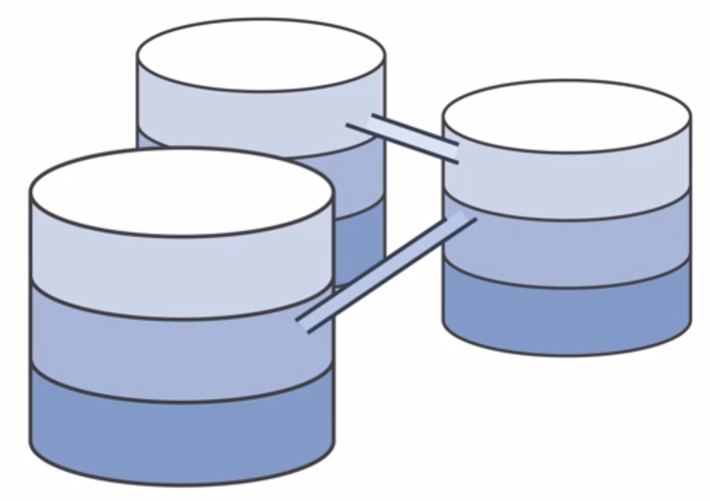
Module 2 Details: AWS Core Services
SECTION 2.0.2: Introduction to Storage Services
Part 1: Elastic Block Store (EBS)
Part 2: Amazon Simple Storage Service (S3)
Part 3: Amazon Elastic File System (EFS)
Part 4: Amazon Glacier
SECTION 2.0.3: Amazon Virtual Private Cloud (VPC)
SECTION 2.0.4: Introduction to Database Services
Part 1: Amazon Relational Database Systems (RDS)
Part 2: Amazon DynamoDB
Part 3: Amazon Redshift
Part 4: Amazon Aurora
Notes:
In Section 2, we move to another core service, storage. In parts 1 and 2, we start by reviewing Elastic Block Storage (ELB) and then move on to Amazon Simple Storage Service (SSS). Part 3 looks at Amazon Elastic File System (EFS) and Part 4 reviews Amazon Glacier.
Section 3 reviews the networking core service, Amazon Virtual Private Cloud (VPC).
Finally, Section 4 introduces a variety of database services including Amazon Relational Database Service in Part 1, Amazon DynamoDB in Part 2, Amazon Redshift in Part 3, and Amazon Aurora in Part 4.

Slide 10
Module 2 Details: AWS Core Services
SECTION 2.0.5: Elastic Load Balancing, Amazon CloudWatch, Auto Scaling
Part 1: Elastic Load Balancing (ELB)
Part 2: Amazon CloudWatch
Part 3: Auto Scaling
Notes:
In Module 5, we review Load Balancing, Amazon CloudWatch and Auto Scaling to understand how to build robust and highly available architectures.

Slide 11
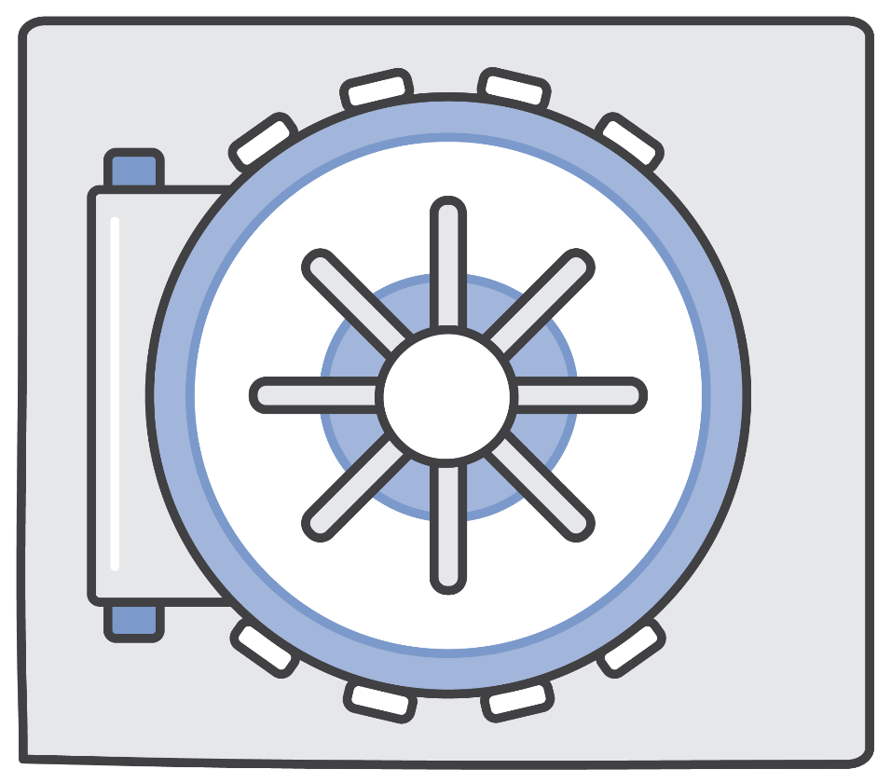
Module 3 Details: AWS Cloud Security
Part 1: AWS Shared Responsibility Model
Part 2: AWS Identity and Access Management (IAM)
Part 3: AWS Trusted Advisor
Part 4: AWS CloudTrail
Part 5: AWS Config
Part 6: AWS Day One Best Practice Review
Part 7: AWS Security and Compliance Programs
Part 8: AWS Security Resources
Optional: AWS Day One Demonstration
Notes:
Every solution needs security and in Module 3, we review AWS Cloud Security. Part 1 lays the foundation for understanding AWS security by explaining the AWS Shared Responsibility Model. In Part 2, we learn about AWS Identity and Access Management (IAM) which enables you to securely manage access to AWS services and resources. Part 3 will review AWS Trusted Advisor, an online resource to help you reduce cost, increase performance, and improve security of your AWS environment. Part 4 looks at CloudTrail, a service that enables governance, compliance, operational auditing, and risk auditing for your AWS account. In Part 5 we review AWS Config, as service that enables you to assess, audit, and evaluate the configurations of AWS resources.
Part 6 brings the security practices together and provides insight into Day One best practices that every account should follow. Part 7 addresses AWS security and compliance programs that are available to address compliance requirements, Finally,
Part 8 wraps up with some additional AWS security resources that are available to ensure all of your security concerns are addressed.
An optional section is provided for a step by step walk through of a Day One implementation for setting up your AWS account.

Slide 12

Module 4 Details: Cloud Architecting
Part 1: Introduction to the Well-Architected Framework
Part 2: Well-Architected Design Principles
Part 3: Understanding High Availability and Reliability
Part 4: Scaling
Notes:
Module 4 introduces cloud architecting. It provides prescriptive guidance to cloud architects so that they can build highly scalable and elastic applications optimized to run in AWS cloud.

Slide 13

Module 5 Details: Cloud Billing and Support
Part 1: Introduction to AWS Organizations
Part 2: AWS Cost Explorer
Part 3: Overview of AWS Technical Support Plans and Costs
Notes:
Module 5, the billing and support services module, introduces you to AWS Organizations and how to manage multiple AWS accounts and consolidated billing. We’ll take a closer look at AWS Cost Explorer and tools that enable you to view and estimate costs.
Finally, we will close with an overview of AWS technical support plans and costs and how to find AWS white papers and documentation on all AWS services, features, and resources.

Slide 14
Part 2: Create Your AWS Training Portal Account
Notes:
Introducing Part 2, where you’ll create your AWS Training and Portal Account.

Slide 15
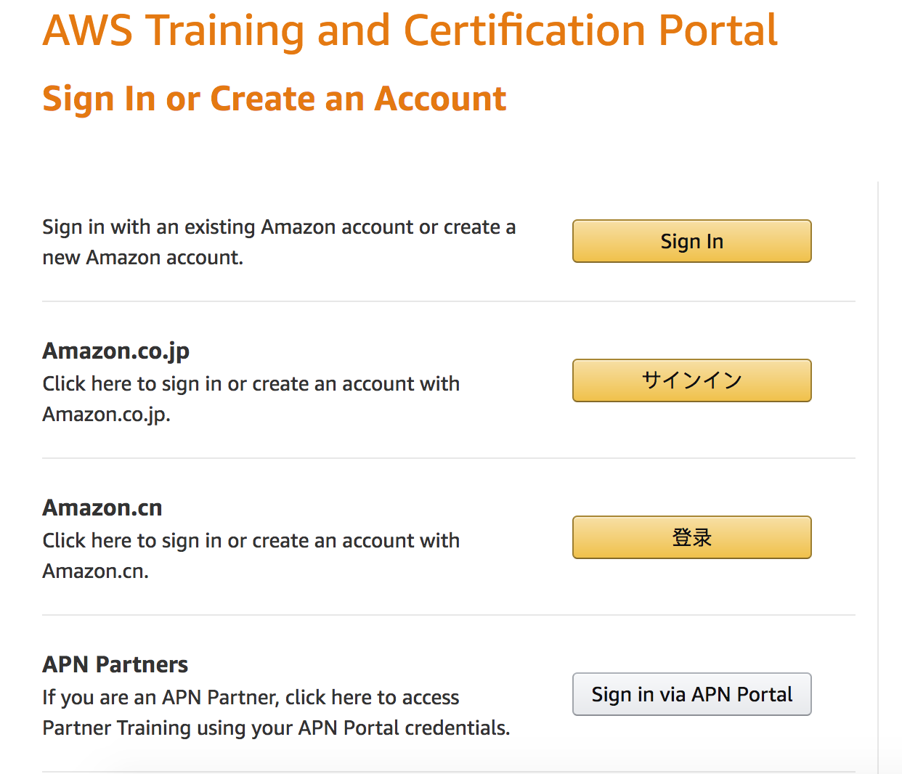
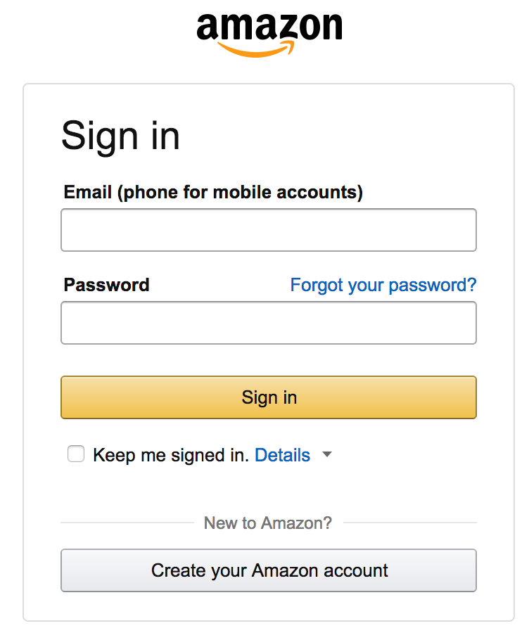
Log in to the AWS Training Portal
Self-registration link provided by your instructor.
Click Create an Account or Sign In.
Use your existing Amazon.com account or create a new one.
Notes:
You will need to obtain a self-registration link to begin the setup process. This is available from an instructor. If you have never signed in before, select Create an Account. After your account is set up, select Sign In. Your training account must be connected to an Amazon.com account. You can use your existing Amazon.com account or create a new one.

Slide 16
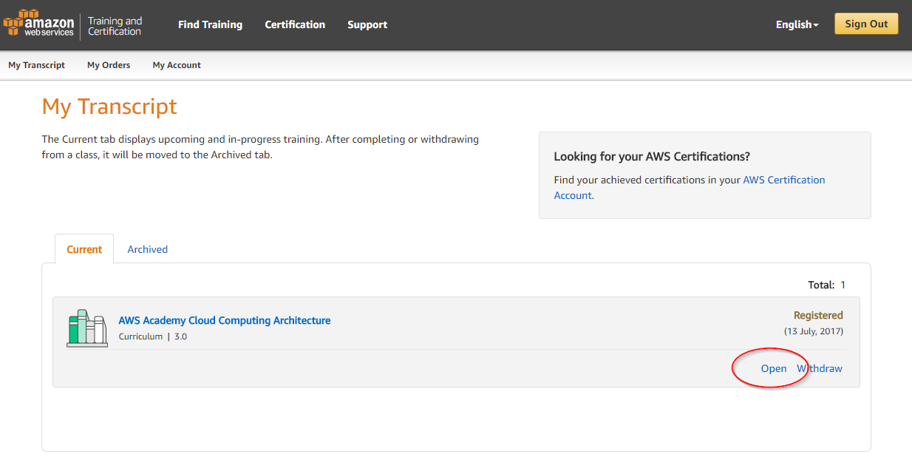
Accessing Curriculum Content
Always available within the My Transcript tab.
Click Open to see curriculum components.
Notes:
The curriculum content is available within the My Transcript tab. Select open to see curriculum components.
Note: Although it is tempting to click on the course name hyperlink, that will only open a course description. Select open to access course content.

Slide 17
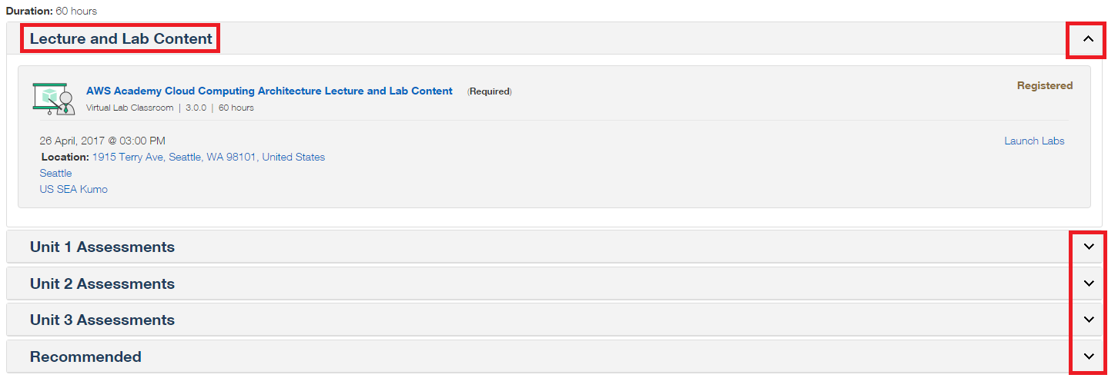
Accessing Lecture and Labs Content
Curriculum includes lectures, lab content, and assessments.
Sections can be collapsed or expanded.
Notes:
The curriculum content includes lectures, lab content, and assessments. Selecting the arrows on the right-hand side enables you to collapse or expand content sections.

Slide 18
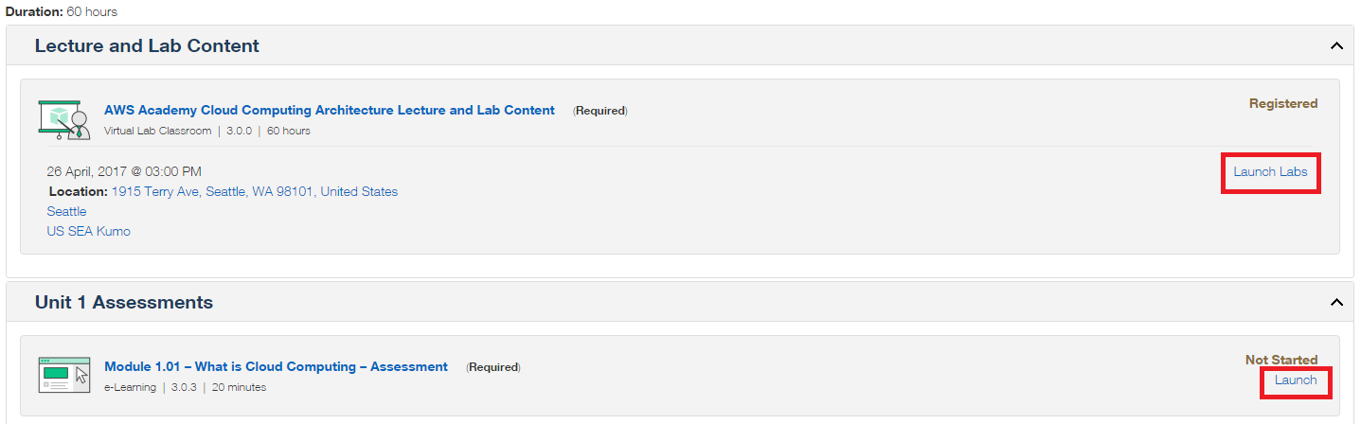
Navigating the Curriculum
To access lecture and lab materials, click the Launch Labs button.
To access assessments, click the Launch button.
Notes:
It is easy to navigate to different curriculum objects. To access lecture and lab materials, select the Launch Labs button. This will direct you to the lab environment. To complete an assessment, select the Launch button.

Slide 19
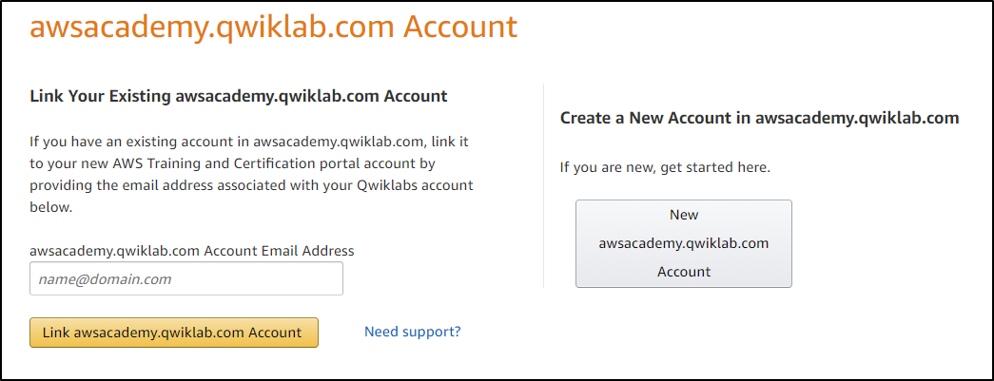
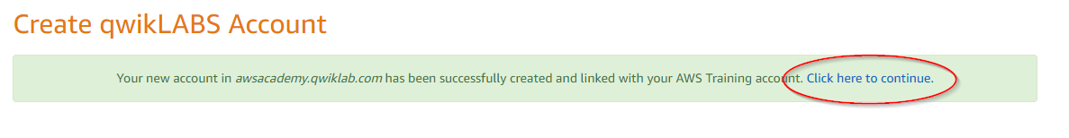
Accessing Lecture and Labs Content
Click Create new account in awsacademy.qwiklabs.com
Note: You only need to do this the first time you open the training portal. Thereafter, you’ll be redirected.
Notes:
When you click on Launch Labs and are directed to the lab environments, you will need to create a new account for the lab environment. Select create new account in awsacademy.qwiklabs.com. You will only need to do this the first time you try to access the labs.

Slide 20
Part 3: Access Your Course Materials
Notes:
In Part 3, we will review how to access your course materials.

Slide 21
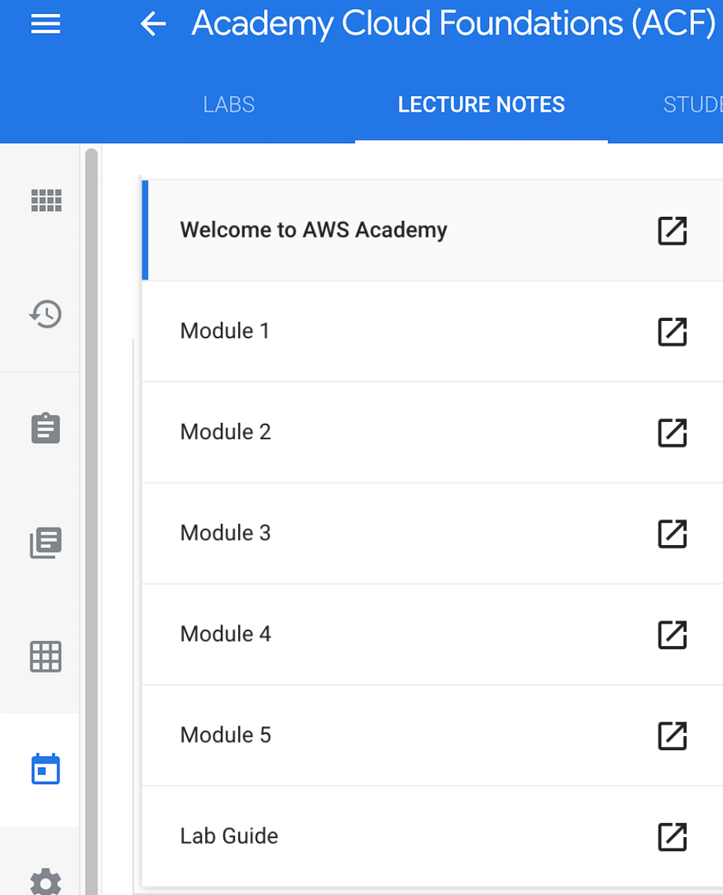
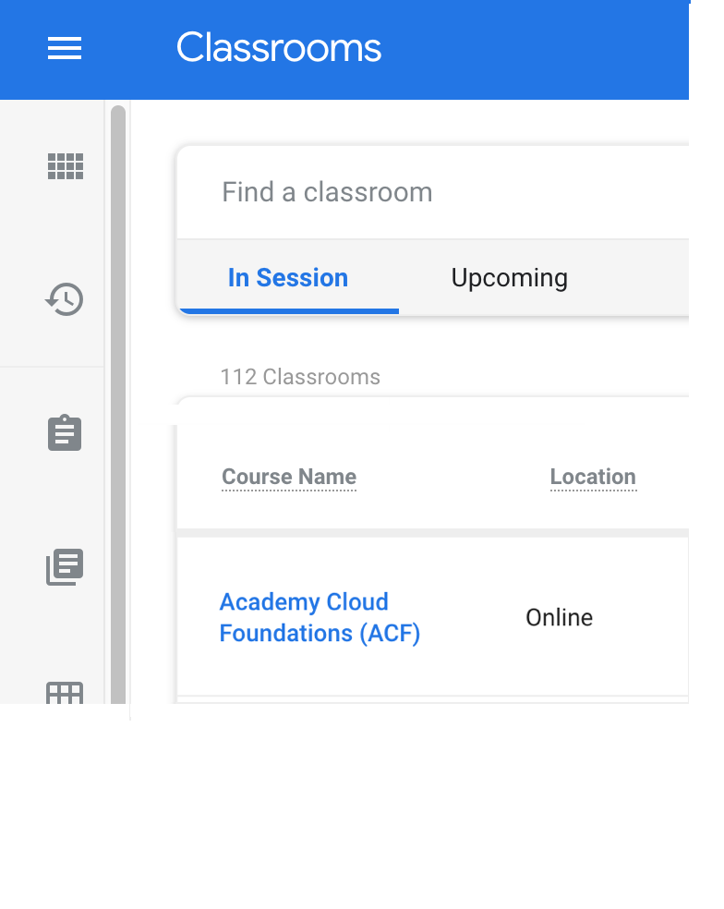
Lecture Content Navigation
Select your class.
Select a unit to display the student guide for that part of the course.
Notes:
To access lecture content, select your class from the list. Select the unit that you will be working on. This will display the student guide for that part of the course.

Slide 22
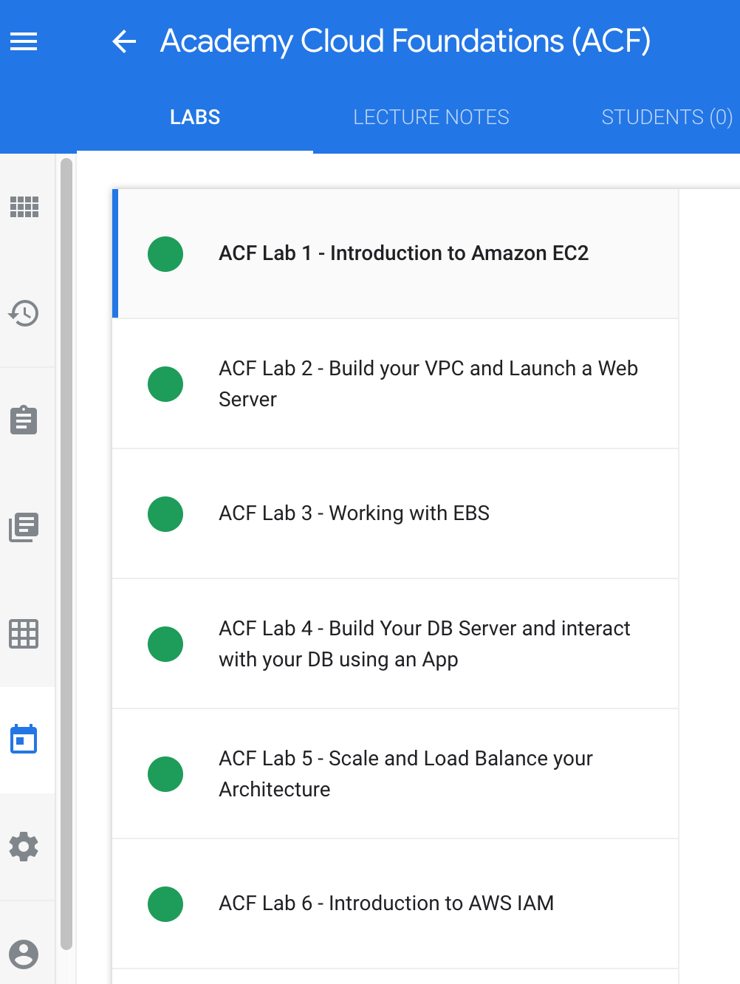

Lab Navigation
The Labs tab contains all the lab exercises.
When advised by your instructor, select a lab and follow the lab instructions.
Notes:
The Labs tab contains all of the lab exercises. As instructed, select a lab and follow the lab instructions.

Slide 23
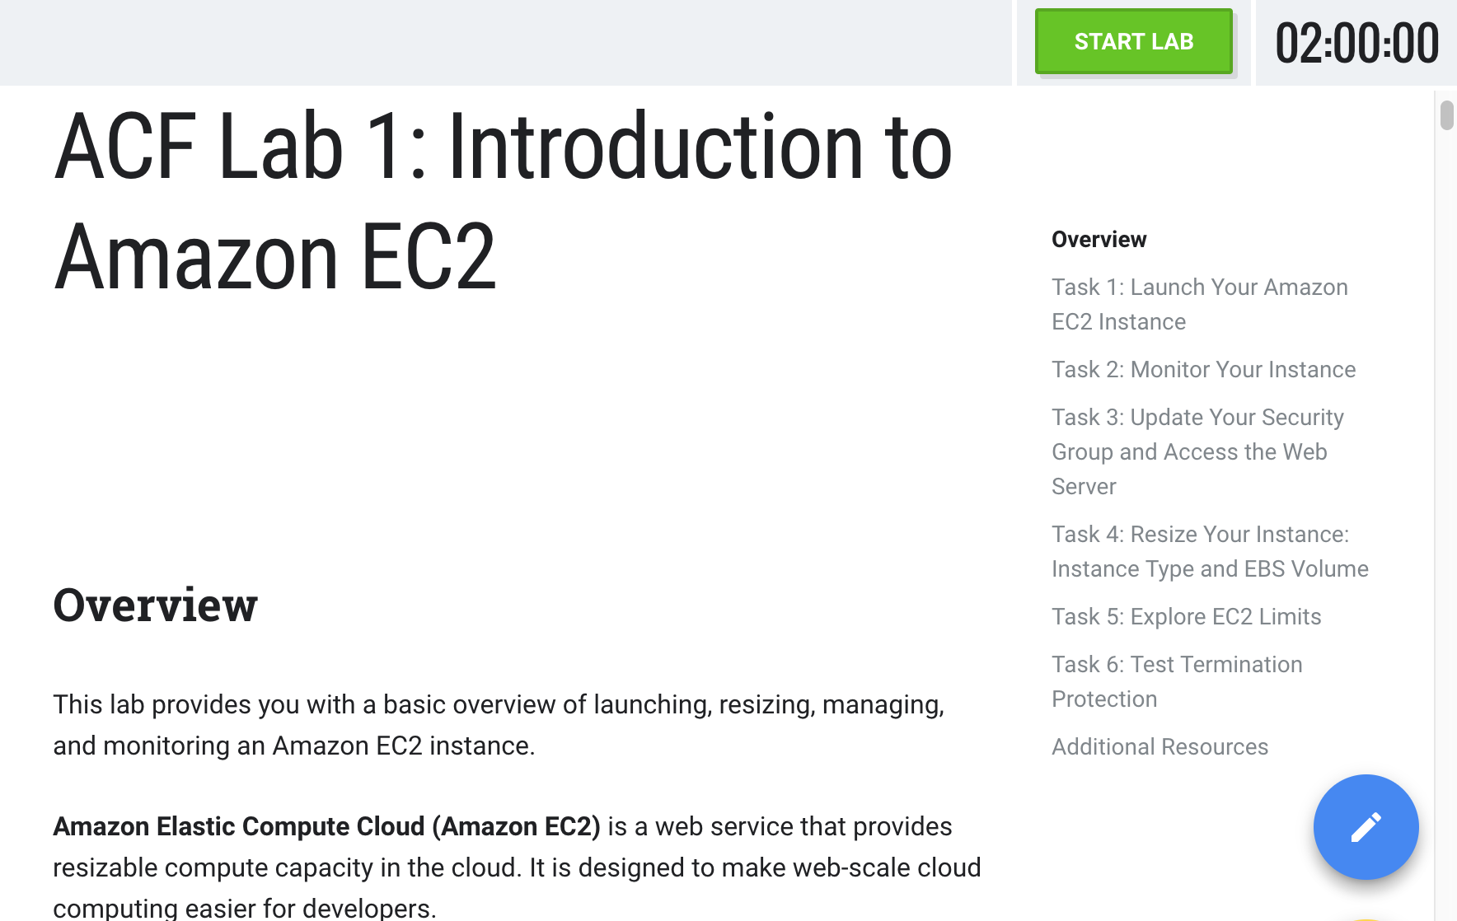
Start the Lab
To start the lab, click on Start Lab.
Notes:
Labs must be “started” before beginning the lab to activate lab resources. To start the lab, select Start Lab.

Slide 24
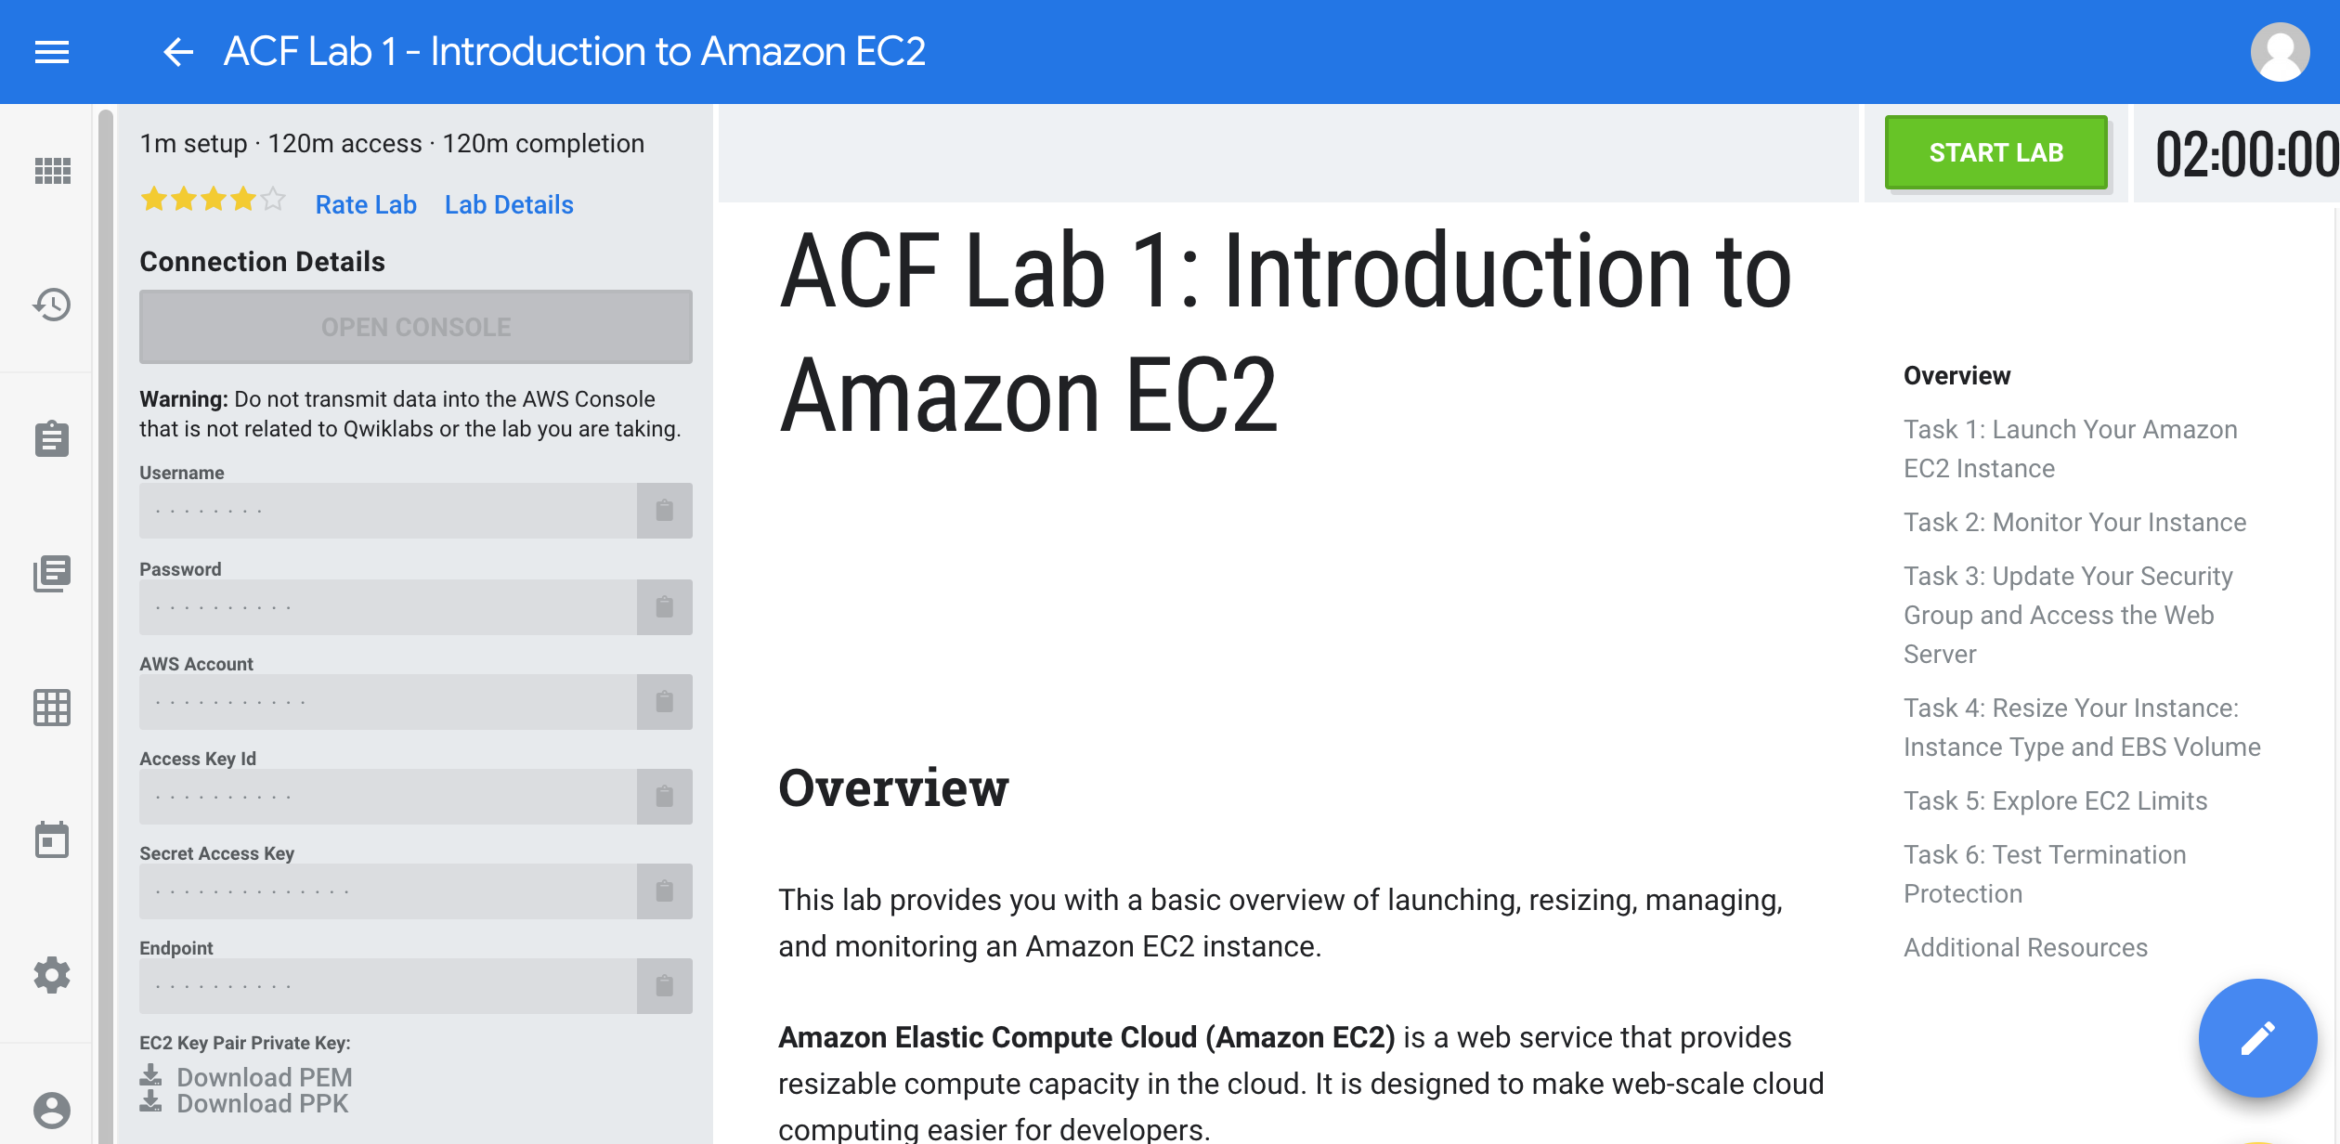
Log in to the Console
Notes:
Once you've started your lab, you need to use the login credentials provided by QwikLabs to log in to the console. You are now ready to begin the lab.
Note: Every lab has its own credentials, e.g. lab #2 cannot be accessed with lab #1's credentials and vice versa.

Slide 25
Optional Resources: AWS Free Tier & AWS Educate
Notes:
In addition to the resources that you will receive from Academy, there are some additional AWS resources you will find helpful, AWS Free Tier, and AWS Educate.

Slide 26
Optional - Part 4: Create Your AWS Free Tier Account
Notes:
In Part 4, we walk through creating your AWS Free Tier Account. The AWS Free Tier Account allows you to try some AWS services free of charge, within certain usage limits. AWS calls this the AWS Free Tier. The free tier is designed to give you hands-on experience with a range of AWS services at no charge. For example, you can explore AWS as a platform by setting up a test website with a server, alarms, and database. You can also try out services for developers, such as AWS CodePipeline, AWS Data Pipeline, and AWS Device Farm.
When you create an AWS account, you are automatically signed up for the free tier for 12 months. Your free tier eligibility expires at the end of the 12-month period. When your free tier expires, AWS starts charging the regular rates for any AWS services and resources that you are using.

Slide 27
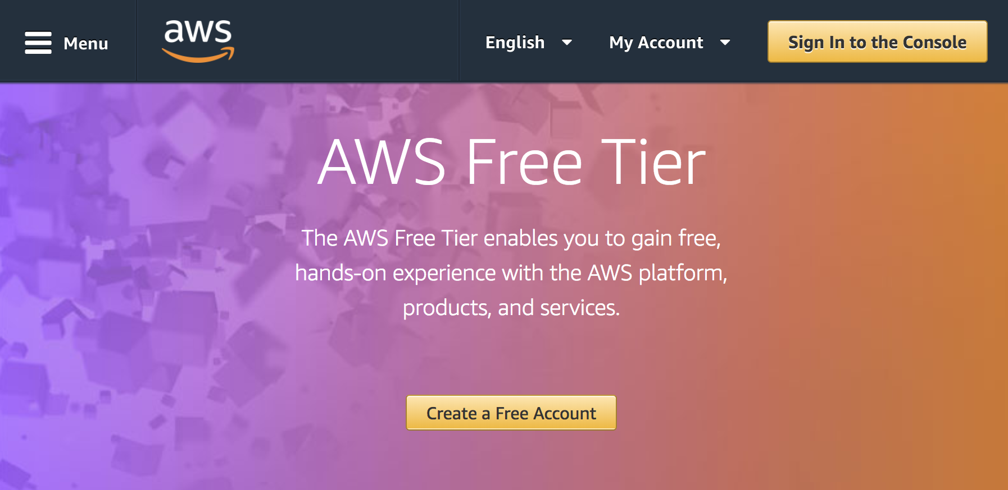
Log in to your AWS Account
Open the aws.amazon.com/free/ link.
Notes:
To set up your AWS Free Tier account, open the link: www.aws.amazon.com/free/.

Slide 28
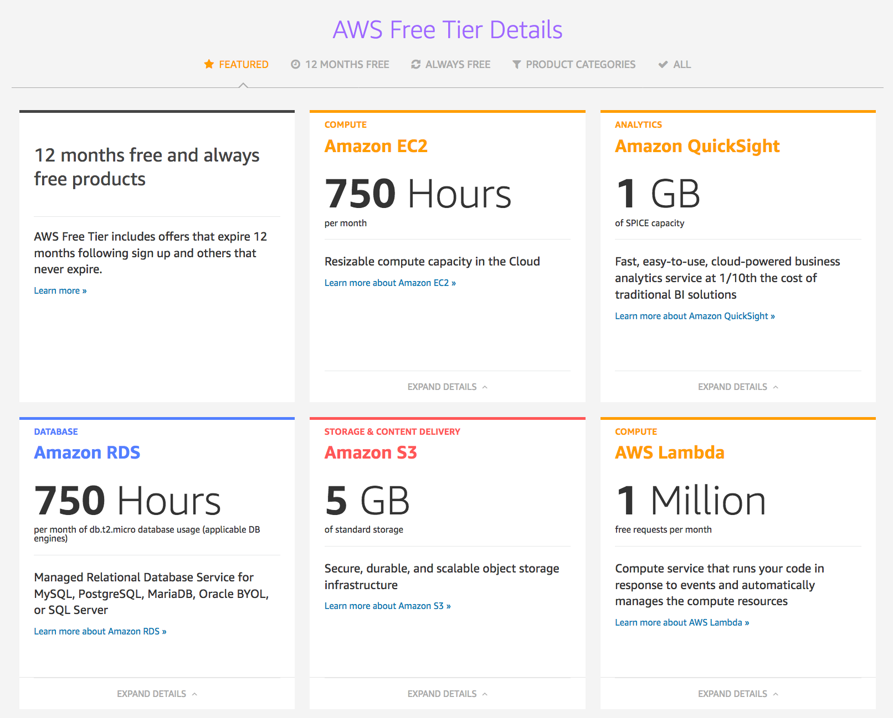
AWS Free Tier Account Details
Notes:
By scrolling down on the page, you will find all of the details of what is included in the Free Tier. AWS Free Tier includes offers that expire 12 months following sign up and others that never expire. The Free Tier includes:
750 hours of EC2 Compute per month
1 GB of SPICE capacity which is a cloud-powered business analytics service
750 hours of Amazon RDS per month
5 GB of Amazon S3 standard storage
1 million free AWS Lambda requests per month

Slide 29
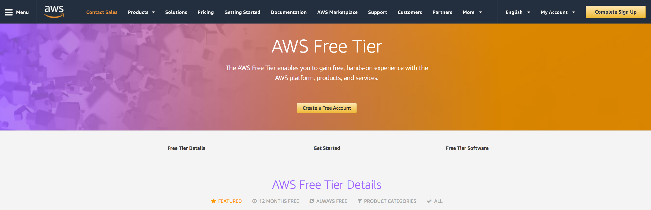
Create your AWS Free Tier Account
Click the Create a Free Account button.
Notes:
To create your Free Tier Account, select Create a Free Account.

Slide 30
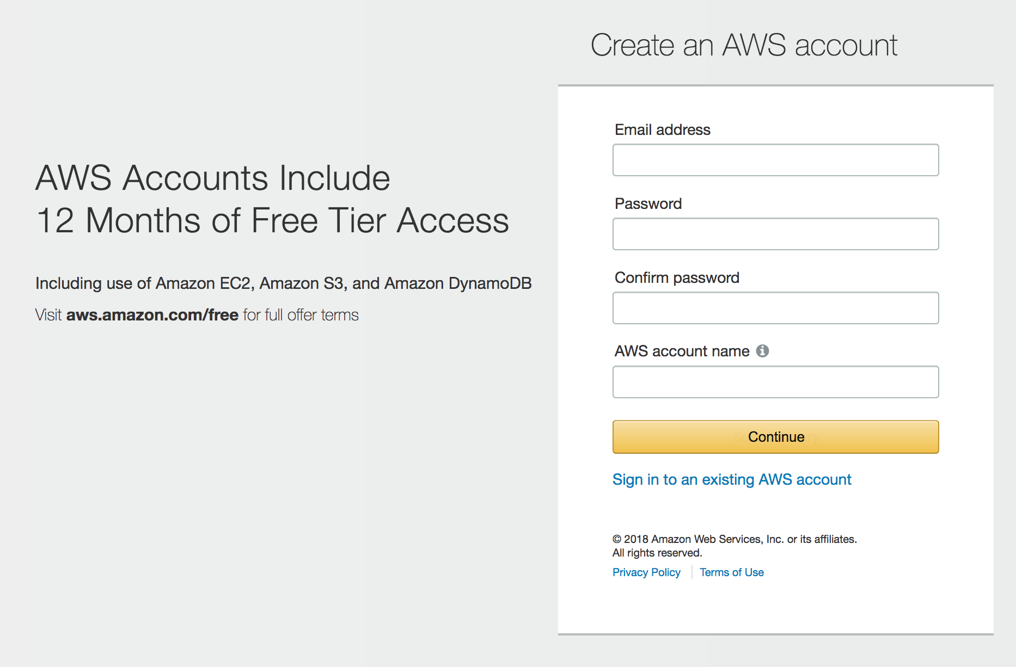
Create your AWS Free Tier Account
Enter your email address
Create a password that:
Is a minimum of 8 or more characters.
Includes a minimum of three of the following mix of character types: uppercase, lowercase, numbers, non-alphanumeric symbols, for example !@#$%^&*()_+-=[ ] { } | ‘
Can not be identical to your AWS account name or email address.
Confirm the password.
Create an AWS account name.
Click Continue.
Notes:
To create your free tier account:
Enter the email address you want associated with your account.
Create a password for your account.
Confirm the account password.
Create an AWS account name.
Finally, select Create Account, and then continue.

Slide 31
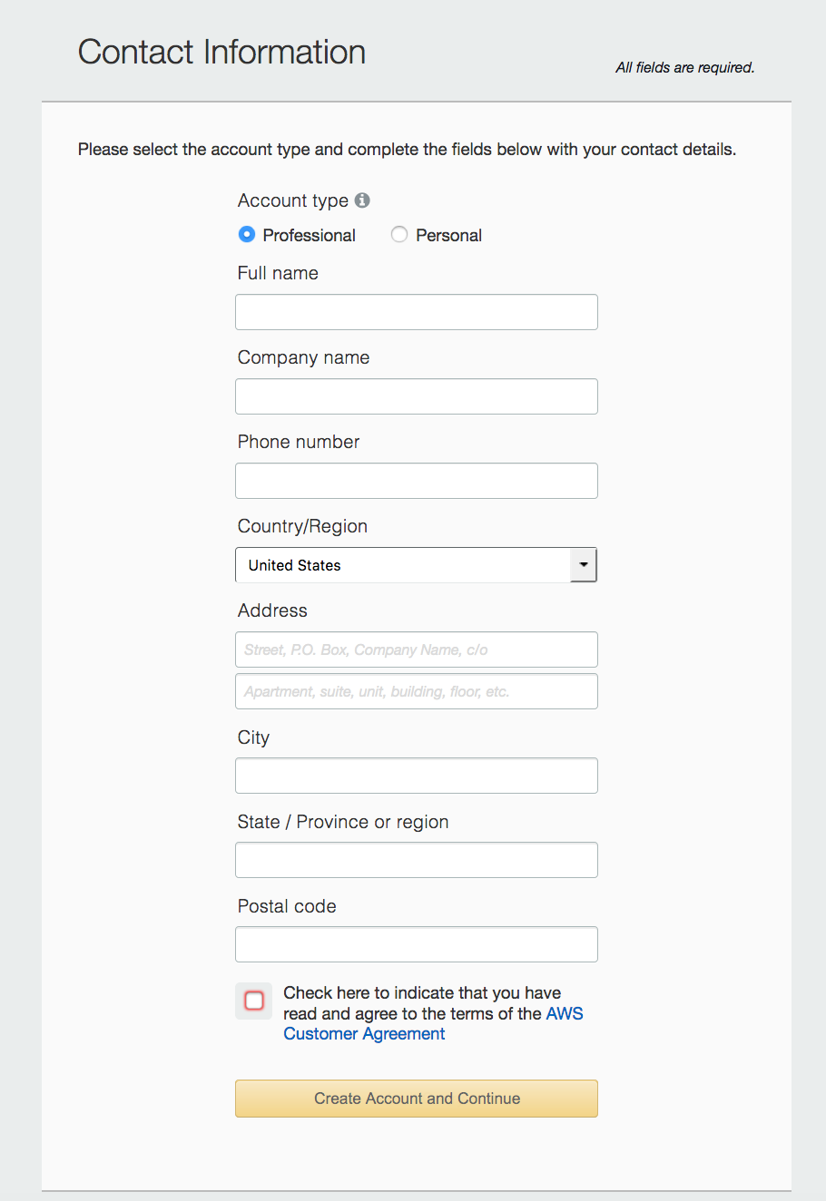
Create your AWS Free Tier Account
Enter your account information.
Click Create Account and Continue.
Notes:
The next dialog box requests your contact information. Complete the form and select Create Account and Continue.

Slide 32
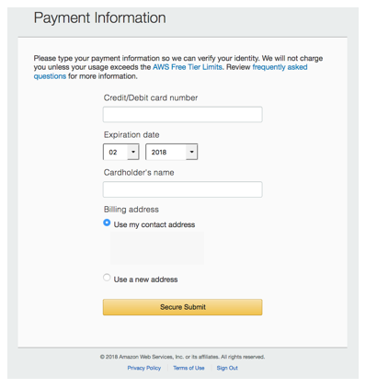
Create your AWS Free Tier Account
Enter your payment information.
Click Secure Submit.
You will not be charged unless your usage exceeds the AWS Free Tier Limits.
Notes:
The next step is to enter your payment information. After the payment information is entered select Secure Submit.
Note: You will not be charged unless your usage exceeds the Free Tier Limits or if you use services not included in the Free Tier.

Slide 33
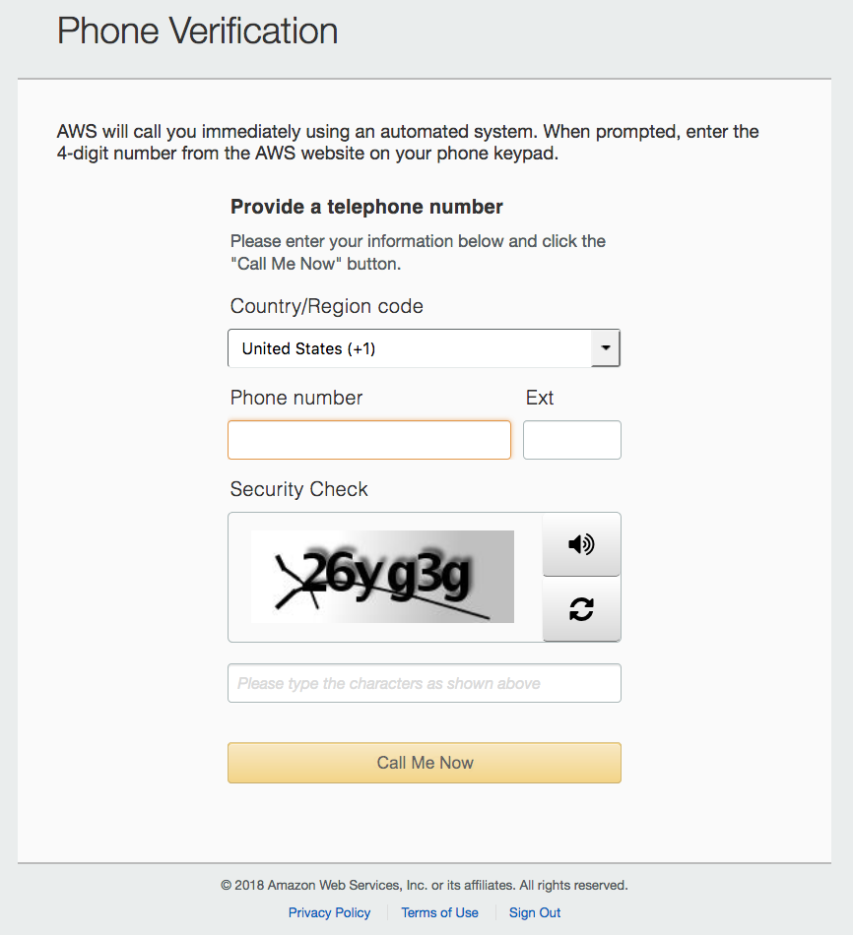
Create your AWS Free Tier Account
Enter your phone number.
Enter the Security Check value.
Click Call Me Now.
Answer the call from AWS and enter the 4-digit number on your phone keypad.
Notes:
The next step in account creation is phone verification. Enter your phone number, the Security Check value and select Call Me Now.
When you answer the call from AWS you will receive a 4-digit number. Insert that number.

Slide 34
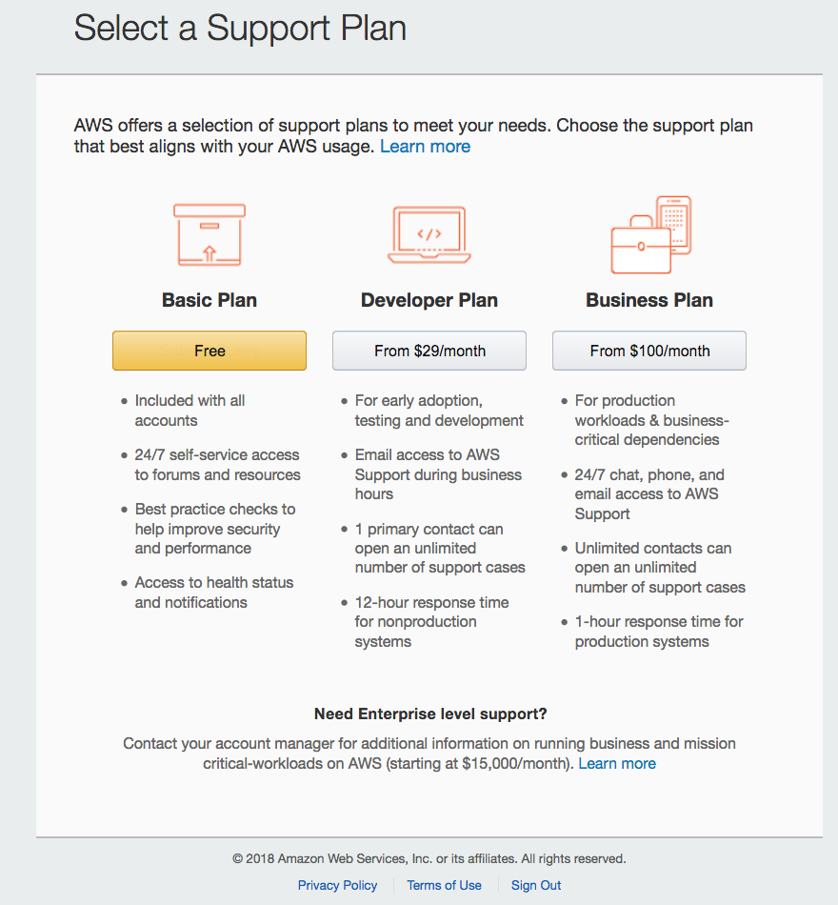
Create your AWS Free Tier Account
Select a support plan. Note: that the Basic Plan is free.
Notes:
The next step is to select a support plan. Please select the Basic Plan which is free.

Slide 35
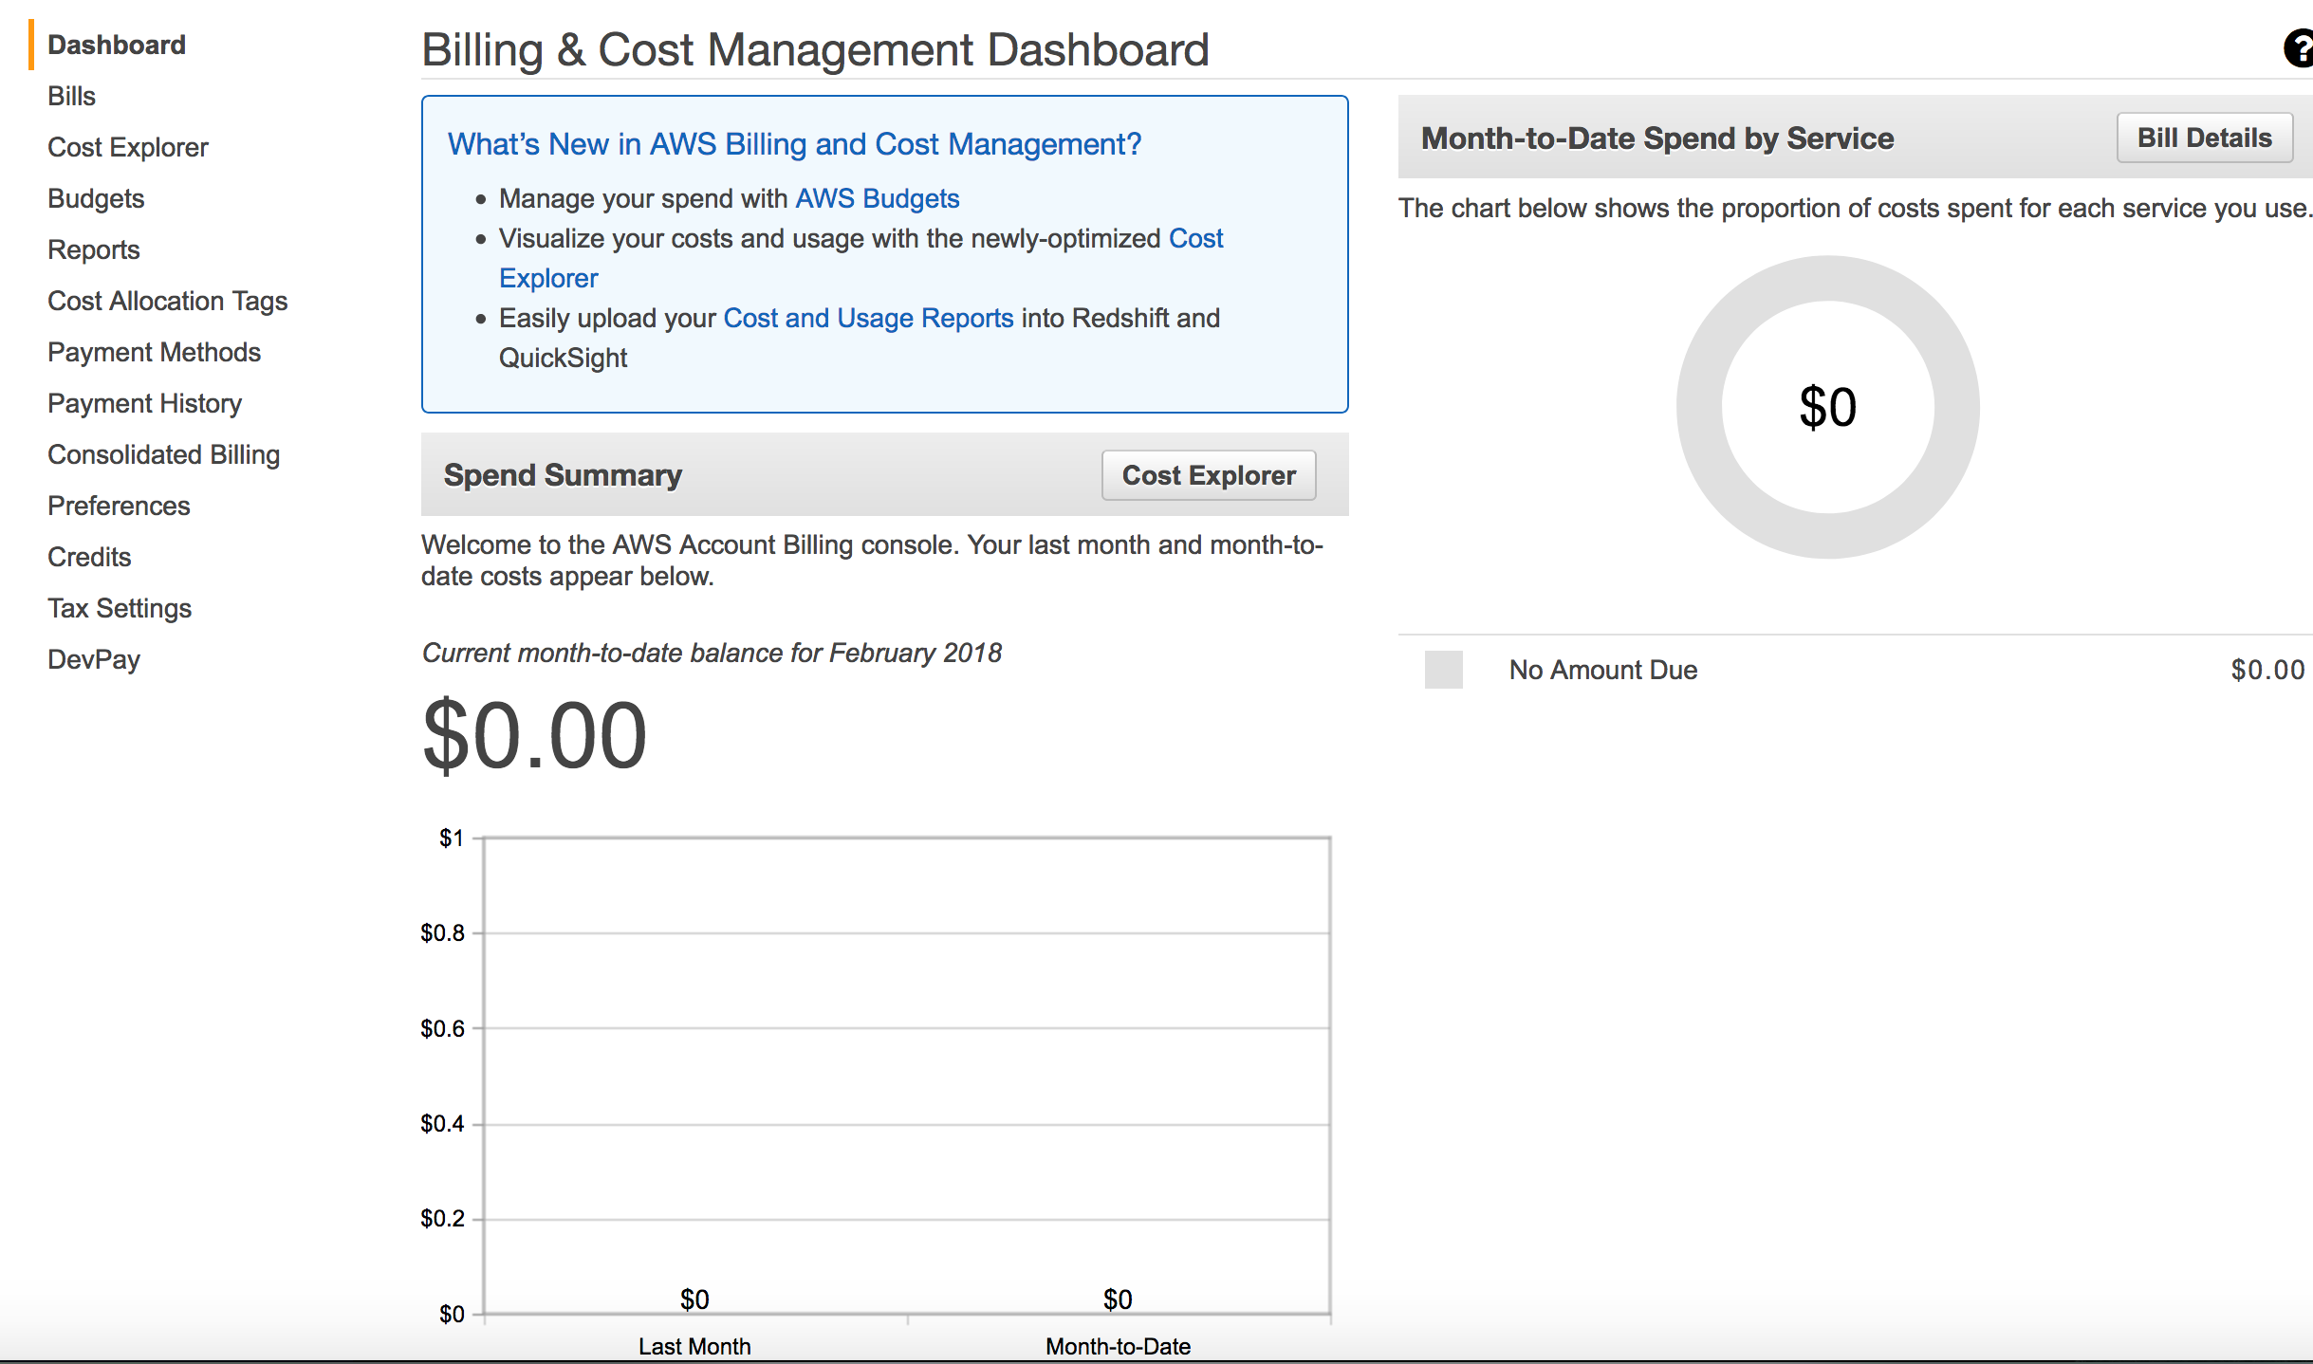
AWS Free Tier Account
Your account is set up.
Consider setting an alert to monitor your account balance in case you accidently leave something turned on.
Click the drop down arrow next to your account name and select My Billing Dashboard.
You can also get here by clicking Services and typing Billing.
Notes:
Congratulations! Your Free Tier account is now set up. You should consider setting up an alert to monitor your account balance in case a service is left on and is incurring charges.
There are a couple of ways to get to the location to set up the alert. You can select the drop-down arrow next to your account name and select My Billing Dashboard. Or, select Services and type Billing.

Slide 36
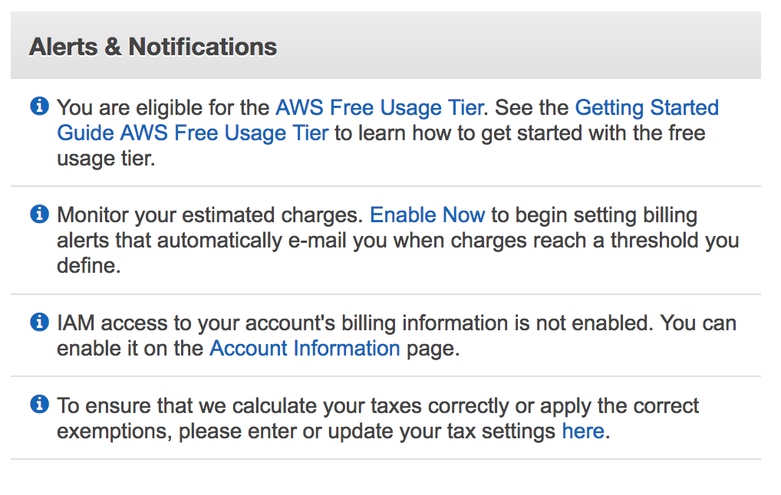
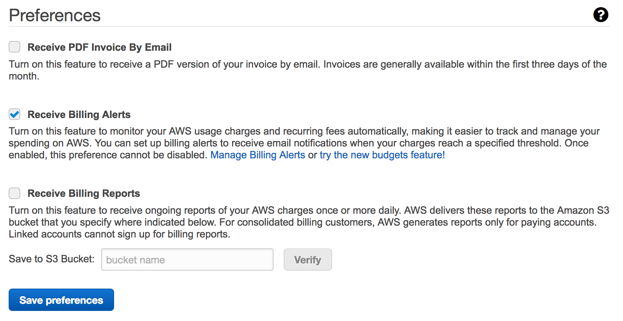
AWS Free Tier Account Billing Alert
Scroll down and choose Enable Now to set up an alert to monitor charges.
Select Receive Billing Alerts and then choose Save preferences.
Choose Manage Billing Alerts.
Choose Create a Billing Alarm.
Notes:
To enable a billing alert, scroll down and select Enable Now to set up an alert to monitor account charges. Select Receive Billing Alerts and then choose Save preferences. Next, choose Manage Billing Alerts and then select Create a Billing Alarm.

Slide 37
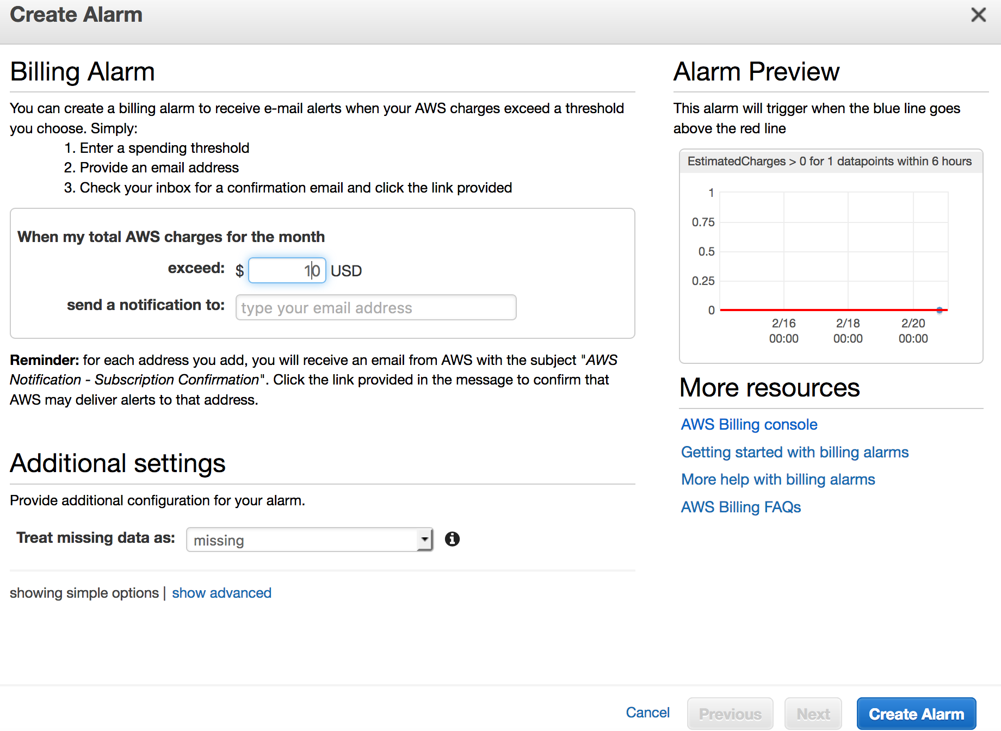
Billing Alert
Under When my total AWS charges for the month exceed box, set the AWS charge amount.
Enter your email address in the field.
Choose Create Alarm.
Confirm your email address.
This alarm will now notify you any time the charges exceed the amount set.
Notes:
In the area, When my total AWS charges for the month exceed, set the amount that you would like an alarm to trigger. For example, if you would like to be alerted if charges exceed $5.00 USD then set that amount to 5. Next, enter the email address where you would like the alert sent and click Create Alarm. You will be asked to confirm your email address.
You now have an alarm that notifies you when the charges exceed the threshold that you set.

Slide 38
Optional - Part 5: Create Your Free AWS Educate Account
Notes:
Introducing Part 5, where we’ll walk you through creating your free AWS Educate Account.

Slide 39
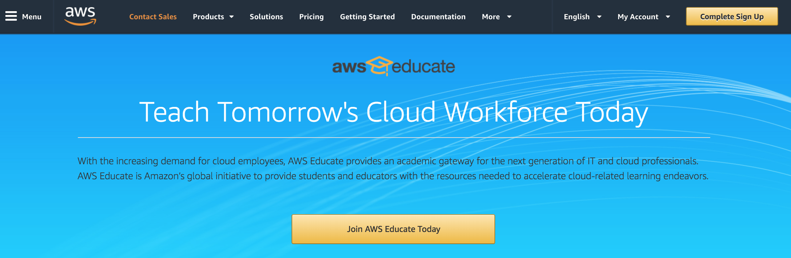
What is AWS Educate?
AWS Educate is Amazon’s global initiative to provide students comprehensive resources for building skills in cloud technology.
Notes:
AWS Educate is Amazon’s global initiative to provide students comprehensive resources for building skills in cloud technology. It offers young learners access to self-paced content designed to introduce cloud computing technologies that drive innovation in fields such as AI, voice and facial recognition, gaming, medical advancements, and more.
For more information, visit the link.

Slide 40
AWS Educate Student Benefits
AWS Credits (annually renewable) | AWS Account: $100 in credits at member institutions; $40 in credits at non-member institutions AWS Educate Starter Account: $75 in credits at member institutions; $30 in credits at non-member institutions
AWS Training | Access to AWS Technical Essentials Training Course (a $600 value) Free access to labs
Curated Content | Ability to select personalized learning pathway with 30+ hours of content per path Earn digital badges that showcase cloud skills Free access to AWS content for homework, labs, or self-study
Collaboration Tools | Student Portal access Student portfolio to store projects in one place Access to Job Board and job postings
Notes:
Like the Free Tier, AWS Educate offers a number of benefits including free services. This includes AWS Credits, free access to tech essentials and labs, learning pathways with curated content, and collaboration tools.
To learn more, visit the link https://aws.amazon.com/education/awseducate/.

Slide 41
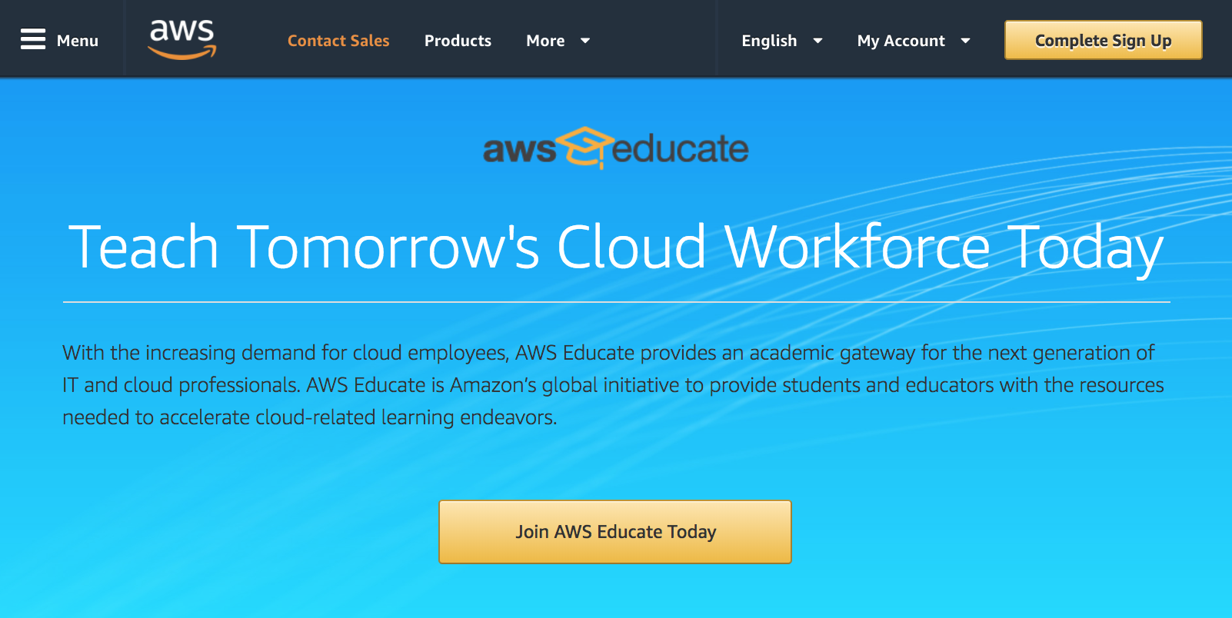
Create an AWS Educate Account
https://aws.amazon.com/education/awseducate/
Click on Join AWS Educate Today
Notes:
To create your AWS Educate Account, visit the link: https://aws.amazon.com/education/awseducate/
and select Join AWS Educate Today.

Slide 42
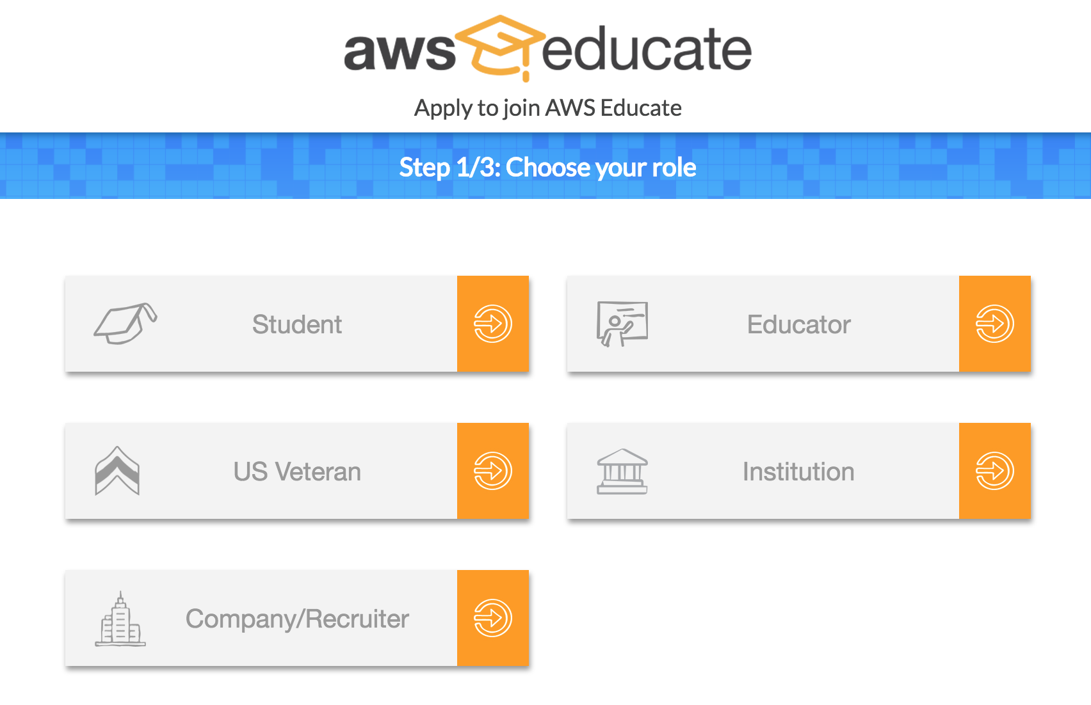
Create an AWS Educate Account
Select your role, choose Student.
Notes:
Select your role as a Student.

Slide 43
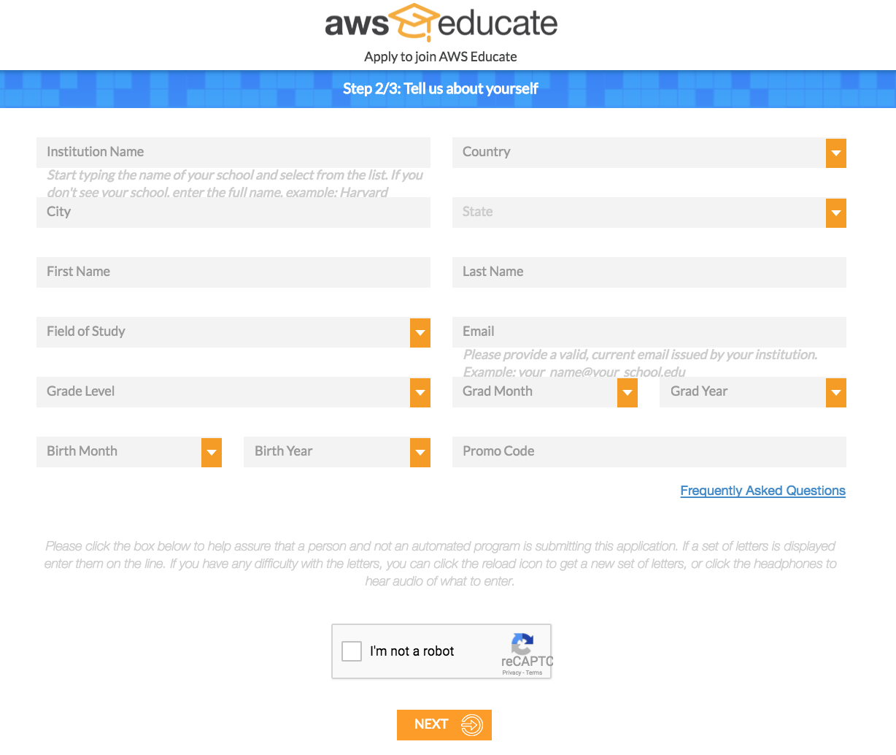
Create an AWS Educate Account
Complete the form with your information and choose Next.
Notes:
Complete the form by filling in your information and then choose Next.

Slide 44
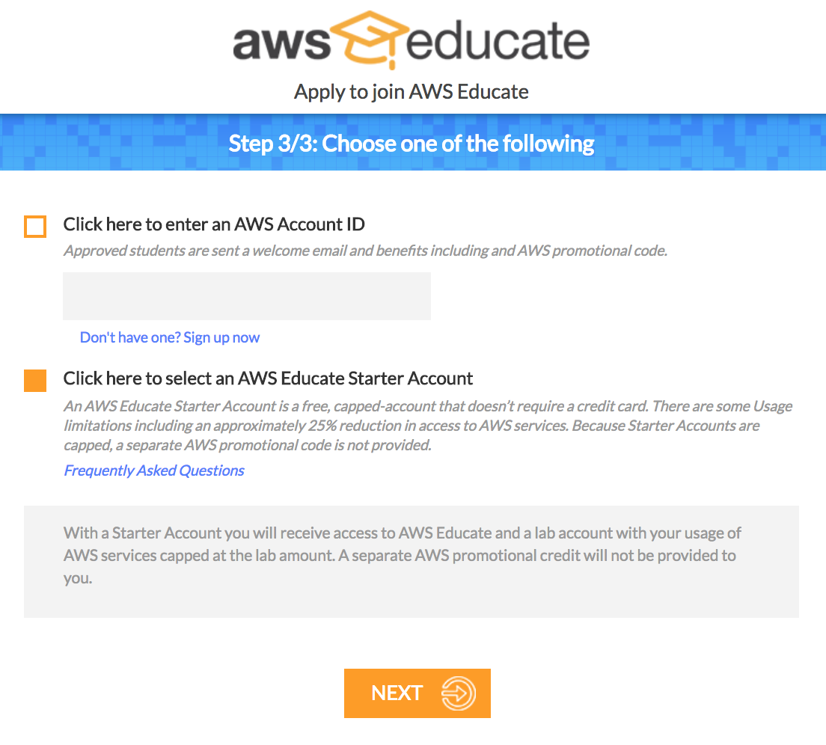
Create an AWS Educate Account
Select the account type.
For a free account (no credit card required), select Click here to select an AWS Educate Starter Account.
Choose Next.
Notes:
Next, you will select the account type. For a free account (no credit card required), select Click here to select an AWS Educate Starter Account. Then, choose Next.

Slide 45
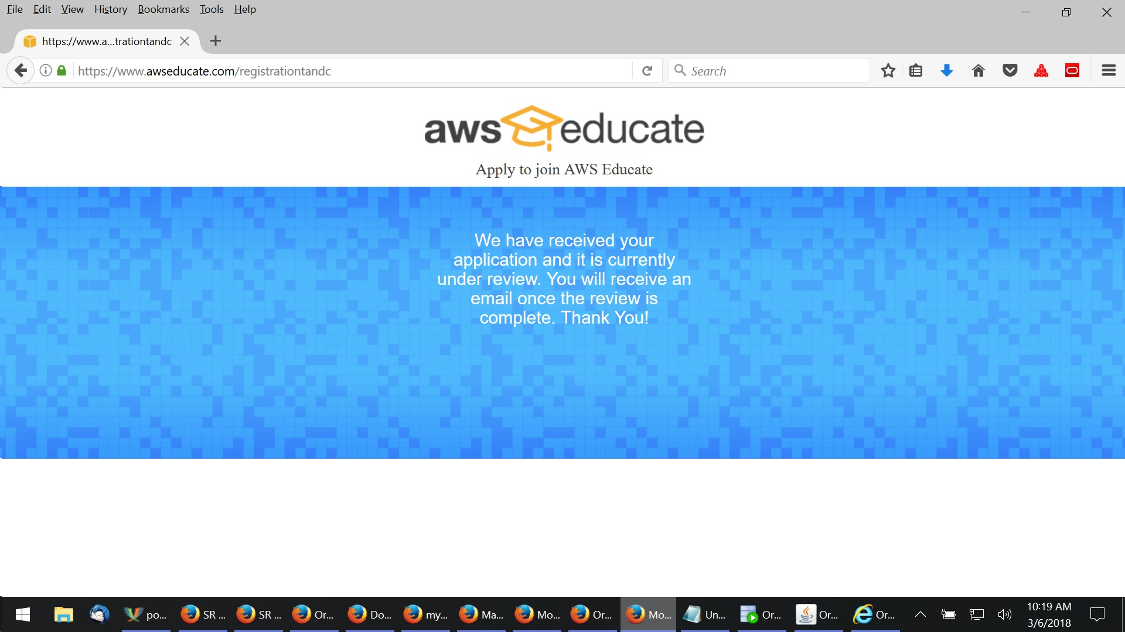
Review and Accept Terms and Conditions
Check your email for a message with a link to verify your email address.
Verify your email address by clicking on the link.
Upon verification, you will be presented with the terms and conditions for your review.
Review and accept the terms and conditions. This notification indicates your application is under review.
You will be notified when the review is complete.
Notes:
Check your email for a message requesting verification of your email address and select the link in that message to provide verification. Upon address verification, you will be presented with the account terms and conditions for your review.
After you review and accept the terms and conditions, your application will be submitted for review and approval. You will be notified when the review is complete.

Slide 46
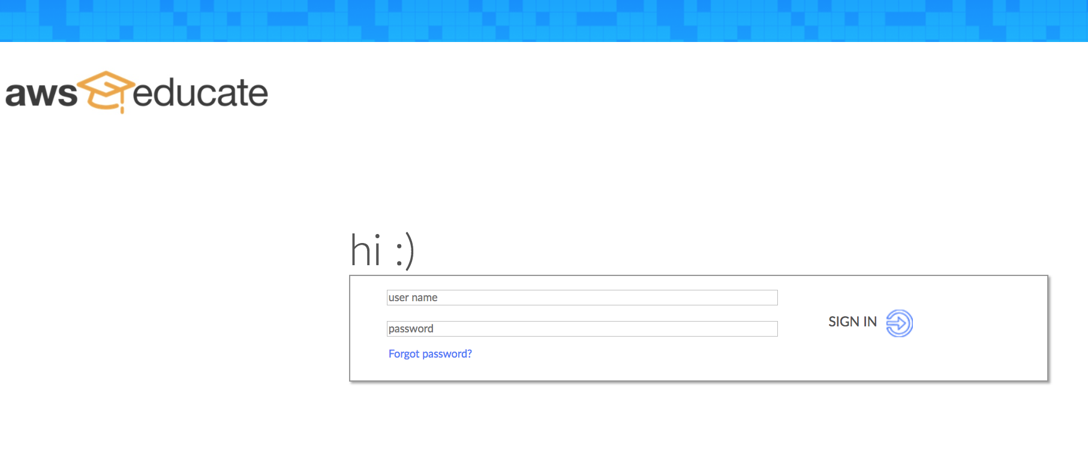
Welcome to AWS Educate!
Go to https://www.awseducate.com/signin/SiteLogin to log in to your AWS Educate account.
Notes:
After your review is approved and your account is approved, you are ready to log in. Visit the link https://www.awseducate.com/signin/SiteLogin to log in to your AWS Educate account.

Slide 47
Up Next: Unit 1 – Introduction to Cloud Computing 1.01 What is Cloud Computing? 1.02 Introduction to Cloud Economics 1.03 AWS Infrastructure Overview
Notes:
Up next, we will start with Unit 1 where we gain an understanding of what cloud computing is, gain insight into the economics of cloud that are driving this transformation, and introduce the AWS Infrastructure.

Slide 48
Thanks for participating!
© 2018 Amazon Web Services, Inc. or its affiliates. All rights reserved. This work may not be reproduced or redistributed, in whole or in part, without prior written permission from Amazon Web Services, Inc. Commercial copying, lending, or selling is prohibited. Corrections or feedback on the course, please email us at: aws-course-feedback@amazon.com. For all other questions, contact us at: https://aws.amazon.com/contact-us/aws-training/. All trademarks are the property of their owners.
Notes:
Thanks for participating!

